Slide 1
TCGA LINCS Data Pipeline

Slide 2
TCGA data
Step 1
Step 2
Step 3
Step 4
TCGA
Raw data
Withdrawn, duplicate제거
(duplicate : Max of the Mean expressed gene)
Tumor, Recurrent, Metastatic, Normal로 나누어 저장
Tumor, Normal만 이용 하나의 데이터 완성
(20,440 X 1,211)

Slide 3
LINCS data
Step 1
Step 2
Step 3
Step 4
LINCS Raw data
Withdrawn, duplicate제거
(duplicate : Max of the Mean expressed gene)
중복된 실험 합침.
(같은 Cell line, 같은 농도, 시간)
원하는 Cell line에 대한 데이터와 약물별로 따로 저장
(Entrez + mRNA Exp)

Slide 4
TCGA data
Raw file의 row, col개수 출력. TCGA 폴더별 M,N,T 개수출력.
Zeta server
Path : /home/arajo0707/TCGA_LINCS/
File:TCGA_ncol_nrow.sh
Command
./TCGA_ncol_nrow.sh
Input data
/home/arajo0707/TCGA_LINCS/TCGA_X/{Cancer name}/TCGA_RNA-Seq_{Cancer name}_N.txt
/home/arajo0707/TCGA_LINCS/TCGA_X/{Cancer name}/TCGA_RNA-Seq_{Cancer name}_T.txt
Index file
/home/arajo0707/TCGA_LINCS/TCGA_preprocess/index_sorted_descending.txt
Output data
/home/arajo0707/TCGA_LINCS/ nrow.txt

Slide 5
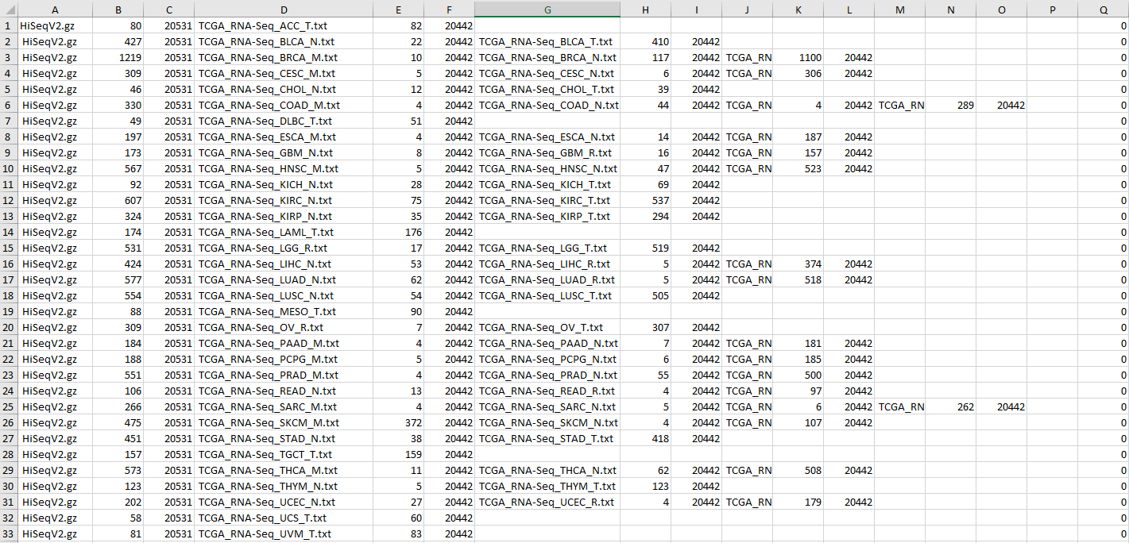
TCGA data

Slide 6

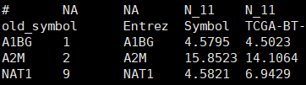

TCGA data
HiSeq.gz
Malignant / Normal/ Tumor 파일모습
WithDrawn : 23개, Duplicate : 67개 (90)
20530*1218 (20440*1218)
M 실제 행열갯수(20440 * 7)
N 실제 행열갯수(20440 * 114)
T 실제 행열갯수(20440 * 1097)
전체파일이름 | 열갯수(헤더포함) | 행갯수(rowname 행포함) | 분할파일이름 | 열갯수 | 행갯수 | 분할파일이름 | 열갯수 | 행갯수 | 분할파일이름 | 열갯수 | 행갯수
HiSeqV2.gz | 1219 | 20531 | TCGA_RNA-Seq_BRCA_M.txt | 10 | 20442 | TCGA_RNA-Seq_BRCA_N.txt | 117 | 20442 | TCGA_RNA-Seq_BRCA_T.txt | 1100 | 20442

Slide 7
TCGA data
과정1: TCGA HTseq파일을 N(normal), T(tumor), M(malignant) 으로 분리하는 과정
Zeta server
Path : /home/arajo0707/TCGA_LINCS/TCGA_preprocess/
File: step1_TCGA_preprocess.R
Command
Rscript step1_TCGA_preprocess.R ./ BRCA T TCGA_RNA-Seq_BRCA_T.txt ./TCGA_mapping.txt
Rscript TCGA_Sample_filter.R {TCGA_directory} {TCGA_cancer_name} {T,M,R,N} {Output_filename} {gene_index_file}
Input data
/home/arajo0707/TCGA_LINCS/TCGA_X/{Cancer name}/TCGA_RNA-Seq_{Cancer name}_N.txt
/home/arajo0707/TCGA_LINCS/TCGA_X/{Cancer name}/TCGA_RNA-Seq_{Cancer name}_T.txt
Index file
/home/arajo0707/TCGA_LINCS/TCGA_preprocess/index_sorted_descending.txt
Output data
/home/arajo0707/TCGA_LINCS/TCGA_X/{Cancer name}/TCGA_RNA-Seq_{Cancer name}_N.txt
/home/arajo0707/TCGA_LINCS/TCGA_X/{Cancer name}/TCGA_RNA-Seq_{Cancer name}_T.txt

Slide 8
TCGA data
과정2: TCGA데이터를 추출하여 GSVA package ssgsea분석
Zeta server
Path : /home/arajo0707/TCGA_LINCS/TCGA_preprocess/step2_TCGA_ssGSEA.R
File: step2_TCGA_ssGSEA.R
Command
Rscript step2_TCGA_GSVA.R ./tft_benchmark_symbol_10TG.txt ../TCGA_X ./ssgsea
Rscript step2_TCGA_GSVA.R {TF-target_gene_files} {drug_subset_path} {output_path}
Input data
/home/arajo0707/TCGA_LINCS/TCGA_X/{Cancer name}/TCGA_RNA-Seq_{Cancer name}_N.txt
/home/arajo0707/TCGA_LINCS/TCGA_X/{Cancer name}/TCGA_RNA-Seq_{Cancer name}_T.txt
Index file
/home/arajo0707/TCGA_LINCS/TCGA_preprocess/index_sorted_descending.txt
Output data
/home/arajo0707/TCGA_LINCS/TCGA_preprocess/ssgsea/TCGA_{Cancer name}_full.txt
/home/arajo0707/TCGA_LINCS/TCGA_preprocess/ssgsea/TCGA_{Cancer name}_ssGSEA.txt
/home/arajo0707/TCGA_LINCS/TCGA_preprocess/ssgsea/TCGA_{Cancer name}_ssGSEA_z-score.txt

Slide 9



TCGA data
Zeta server
Input: /home/arajo0707/TCGA_LINCS/TCGA_X/{Cancer name}/TCGA_RNA-Seq_{Cancer name}_N.txt
Output : /home/arajo0707/TCGA_LINCS/TCGA_preprocess/ssgsea/TCGA_{Cancer name}_full.txt (GSVA 함수에 들어가는 인풋파일)
/home/arajo0707/TCGA_LINCS/TCGA_preprocess/ssgsea/TCGA_{Cancer name}_ssGSEA.txt
/home/arajo0707/TCGA_LINCS/TCGA_preprocess/ssgsea/TCGA_{Cancer name}_ssGSEA_z-score.txt

Slide 10
TCGA data
과정3: ssgsea분석이 완료된 TCGA데이터를 가지고 TCGA score 계산
Zeta server
Path : /home/arajo0707/TCGA_LINCS/TCGA_preprocess/step3_LINCS_ssGSEA.R
File: step3_TCGA_score.R
Command
Rscript step3_TCGA_score.R ./ssgsea ./TCGA_score
Rscript step3_TCGA_score.R {TCGA_ssgsea_zscore_directory} {output_path}
Input data
/home/arajo0707/TCGA_LINCS/TCGA_preprocess/ssgsea/TCGA_{Cancer name}_ssGSEA_z-score.txt
Output data
/home/arajo0707/TCGA_LINCS/TCGA_preprocess/TCGA_score/TCGA_score_{drugname}.txt
/home/arajo0707/TCGA_LINCS/TCGA_preprocess/TCGA_score/TCGA_score_outlier.txt
이후 LINCS step5_enrichment_score_scatter_plot.R 부분에서 TCGA score파일이 인풋으로 사용

Slide 11

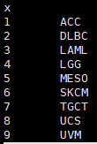
TCGA data
Zeta server
Input: /home/arajo0707/TCGA_LINCS/TCGA_preprocess/ssgsea/TCGA_{Cancer name}_ssGSEA_z-score.txt
Output data
/home/arajo0707/TCGA_LINCS/TCGA_preprocess/TCGA_score/TCGA_score_{drugname}.txt
/home/arajo0707/TCGA_LINCS/TCGA_preprocess/TCGA_score/TCGA_score_outlier.txt

Slide 12
LINCS data
과정1-1 : 필요한 RAW data가져오기 및 기본 duplicate된 gene제거
Zeta server
Path : /home/arajo0707/TCGA_LINCS/LINCS_preprocess
File: step1_LINCS_preprocess.py
Command
python3 step1_LINCS_preprocess.py
Input data
/home/arajo0707/TCGA_LINCS/LINCS_preprocess/LINCS_Gene.txt
/home/arajo0707/TCGA_LINCS/LINCS_preprocess/LINCS_raw.gctx
Index file
/home/arajo0707/TCGA_LINCS/LINCS_preprocess/index_sorted_descending.txt
Output data
/home/arajo0707/TCGA_LINCS/LINCS_preprocess/drug_subset/{drug_name}.txt.gz

Slide 13

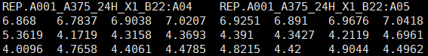
LINCS data
Zeta server
Input: home/arajo0707/TCGA_LINCS/LINCS_preprocess/LINCS_Gene.txt
/home/arajo0707/TCGA_LINCS/LINCS_preprocess/LINCS_raw.txt.gz
Indexfile: /home/arajo0707/TCGA_LINCS/LINCS_preprocess/index_sorted_descending.txt
Output : ./drug_subset/{drug_name}_.txt.gz <같은 농도 시간약물별로 실험값이 합쳐진 파일>

Slide 14



LINCS data
LINCS_raw.txt.gz (12328*345976) <12329*345976>
LINCS_with_entrezid.txt.gz(12326*345980) <12328 * 345980> 정렬안된 LINCS data
LINCS_sort_entraz_12328-345980.txt.gz(12326*345980) <12328 * 345980> 정렬된 LINCS data
파이썬 스크립트로 파일을 분리하면 메모리 부족 문제로 리눅스 명령어를 사용
Ram 450GB 이상 소모되며, 약 18시간 소요

Slide 15
LINCS data – Linux command
파일 핸들링 관련 리눅스 명령어
Column-wise concatenate
paste <(zcat test1.gz) <(zcat test2.gz) | tr -d "\r" | > result.txt
Row-wise concatenate
zcat 1.txt 2.txt >> 12.txt
Sed 명령어
sed '5090d' #5090 번째 행 삭제
sed '5090p' #5090 번째 행 출력
Awk 명령어
awk '{print $23 "\t" $ 26}' #23 ,26번째 열 출력
awk '{print substr($0, index($0, $3))} ' #$0 전체파일 $3 세번째 콜론 index(in,find) in 에 있는 find 의 위치를 리턴 substr(string, start) string에서 start 부터 시작하는 열 반환.(1,2 콜론삭제)
head –n 226 #226번째까지 행
tail -n 10100 #뒤에서부터 10100행
gzip >> LINCS_miawo.txt.gz #gzip으로 압축 > 파일새로생성 >> 있던 파일에 이어붙이기
tr -d "\r" #파일에 캐리지리턴 ^M 을 지움
indexfile_sorting.R > 정렬되지않은 index_sorted_descending.txt 를 3번째 행 ctrl-dose-time 순으로정렬

Slide 16
LINCS data
과정2 : 각 약물별 파일중 [A375 /A549 /BT20 /HCC515 /HELA /HEPG2 /HS578T /HT29 /JURKAT /LNCAP /MCF7 /MDAMB231 /PC3 /SKBR3 /YAPC] 셀라인만 뽑아서 추출
Zeta server
Path : /home/arajo0707/TCGA_LINCS/LINCS_preprocess
File: step2_celline_sorting.py
Command
python3 step2_celline_sorting.py
Input data
/home/arajo0707/TCGA_LINCS/LINCS_preprocess/drug_subset/{drug_name}.txt.gz
Index file
/home/arajo0707/TCGA_LINCS/LINCS_preprocess/index_sorted_descending.txt
Output data
/home/arajo0707/TCGA_LINCS/LINCS_preprocess/drug_cancer_txt/{drug_name}_cancer.txt

Slide 17

LINCS data
Zeta server
Input: /home/arajo0707/TCGA_LINCS/LINCS_preprocess/drug_subset/{dg}_subset.txt.gz
Output : /home/arajo0707/TCGA_LINCS/LINCS_preprocess/drug_cancer/{drug_name}_cancer.txt.gz< 선택된 셀라인만 골라진 파일>
Indexfile: /home/arajo0707/TCGA_LINCS/LINCS_preprocess/index_sorted_descending.txt
총약물 1826개에서 1769개로 축소. 비교 결과파일
Output validation file: /home/arajo0707/TCGA_LINCS/LINCS_preprocess/step2_celline_sorting_validation.txt

Slide 18
LINCS data
과정3: LINCS data를 ssgsea분석
Zeta server
Path : /home/arajo0707/TCGA_LINCS/LINCS_preprocess
File: step3_LINCS_ssGSEA.R
Command
Rscript step3_LINCS_ssGSEA.R ./tft_benchmark_symbol_10TG.txt ./drug_cancer_entrez_txt ./ssgsea
Rscript step3_LINCS_ssGSEA.R {TF-target_gene_files} {drug_subset_path} {output_path}
Input data
/home/arajo0707/TCGA_LINCS/LINCS_preprocess/drug_cancer_entrez_txt /{drug_name}.txt.gz
Index file
/home/arajo0707/TCGA_LINCS/LINCS_preprocess/index_sorted_descending.txt
Output data
/home/arajo0707/TCGA_LINCS/LINCS_preprocess/ssgsea/LINCS_ssGSEA_input.txt
/home/arajo0707/TCGA_LINCS/LINCS_preprocess/ssgsea/LINCS_ssGSEA.txt
/home/arajo0707/TCGA_LINCS/LINCS_preprocess/ssgsea/LINCS_ssGSEA_z-score.txt

Slide 19

LINCS data
Zeta server
Input: /home/arajo0707/TCGA_LINCS/LINCS_preprocess/drug_cancer/{drug_name}_cancer.txt
Output :/home/arajo0707/TCGA_LINCS/LINCS_preprocess/ssgsea/LINCS_ssGSEA_input.txt (GSVA 함수에 들어가는 인풋파일)
/home/arajo0707/TCGA_LINCS/LINCS_preprocess/ssgsea/LINCS_ssGSEA.txt
/home/arajo0707/TCGA_LINCS/LINCS_preprocess/ssgsea/LINCS_ssGSEA_z-score.txt
/home/arajo0707/TCGA_LINCS/LINCS_preprocess/step3_GSVA_outlier.txt

Slide 20
LINCS data
과정4: cancer celline에 DMSO와함께 GSVA package ssgsea분석
Zeta server
Path : /home/arajo0707/TCGA_LINCS/LINCS_preprocess
File: step4_LINCS_score.R
Command
Rscript step4_LINCS_score.R
Input data
/home/arajo0707/TCGA_LINCS/LINCS_preprocess/ssgsea/LINCS_ssGSEA_z-score.txt
Index file
/home/arajo0707/TCGA_LINCS/LINCS_preprocess/index_sorted_descending.txt
Output data
/home/arajo0707/TCGA_LINCS/LINCS_preprocess/LINCS_score/LINCS_score_{drugname}.txt
/home/arajo0707/TCGA_LINCS/LINCS_preprocess/LINCS_score/LINCS_score_outlier.txt
Notes:
Index, input file 경로가 지정되어있음

Slide 21
LINCS data
Zeta server
Input: /home/arajo0707/TCGA_LINCS/LINCS_preprocess/ssgsea/LINCS_ssGSEA_z-score.txt
Output :/home/arajo0707/TCGA_LINCS/LINCS_preprocess/LINCS_score/LINCS_score_{drugname}.txt

Slide 22
LINCS data
과정5: Plotting 을 위한 전체 LINCS, TCGA Enrichment score file 계산 및 L-score 계산파일
Zeta server
Path : /home/arajo0707/TCGA_LINCS/LINCS_preprocess
File: step5_enrichment_score_sctter_plot.R
Command
Rscript step5_enrichment_score_sctter_plot.R
Input data
/home/arajo0707/TCGA_LINCS/LINCS_preprocess/LINCS_score/LINCS_score_{drugname}.txt
/home/arajo0707/TCGA_LINCS/TCGA_preprocess/TCGA_score/TCGA_score_{drugname}.txt
Index file
/home/arajo0707/TCGA_LINCS/LINCS_preprocess/index_sorted_descending.txt
Output data
/home/arajo0707/TCGA_LINCS/LINCS_preprocess/LINCS_score/Enrichment_score_LINCS_total.txt
/home/arajo0707/TCGA_LINCS/TCGA_preprocess/TCGA_score/Enrichment_score_TCGA_total.txt
/home/arajo0707/TCGA_LINCS/LINCS_preprocess/LINCS_score/scatterplot/{cancer_name}/{cancer_name}_{drugname}.tiff
/home/arajo0707/TCGA_LINCS/LINCS_preprocess/L-score_final_result_file.txt

Slide 23
LINCS data
Zeta server
Input:/home/arajo0707/TCGA_LINCS/LINCS_preprocess/LINCS_score/LINCS_score_{drugname}.txt
Output:
/home/arajo0707/TCGA_LINCS/LINCS_preprocess/LINCS_score/Enrichment_score_LINCS_total.txt
/home/arajo0707/TCGA_LINCS/TCGA_preprocess/TCGA_score/Enrichment_score_TCGA_total.txt
/home/arajo0707/TCGA_LINCS/LINCS_preprocess/L-score_final_result_file.txt
/home/arajo0707/TCGA_LINCS/LINCS_preprocess/LINCS_score/scatterplot/{cancer_name}/{cancer_name}_{drugname}.tiff
각 암디렉터리별로 1732개의 결과파일이 .tiff로 저장

